Slide 1


Vision to Sound: Enabling Accessibility for Visually Impaired
AY 2021-25
GITAM UNIVERSITY
Major Project
Project ID: CS4
A University should be a place of light, of liberty, and of learning.
Department of Electrical Electronics and Communication Engineering
Project Team:
BU21EECE0100161 Alli Gopi
BU21EECE0100494 Bhoomika N
Project Mentor:
Dr. Aravind Kumar
www.gitamedu.com

Slide 2


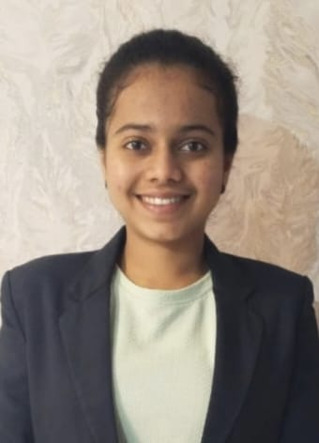
Project Group – Details
Photo
Track
Roll No
Name
Photo
ECE AI/ML
BU21EECE0100161
Alli Gopi
Photo
ECE
BU21EECE0100494
Bhoomika N

Slide 3
Abstract
Global Impact of Visual Impairments: Over 2.2 billion people globally, including 70 million in India, suffer from vision impairments, significantly affecting daily activities such as reading and navigating environments.
Project Objective: "Vision to Sound" aims to enhance accessibility for visually impaired individuals by converting visual information into auditory descriptions using machine learning and embedded systems.
Technology Utilized: The project employs convolutional neural networks (CNNs) to analyze images and Long Short-term Memory (LSTM) to generate descriptions, which are then converted into speech through text-to-speech synthesis.
Portable and Low-Power Solution: The system is designed for real-time processing and is deployed on a compact, portable platform with low power consumption, delivering auditory information via headphones or speakers.
Improved Accessibility and Independence: By bridging visual and auditory perception, this innovative system empowers visually impaired individuals, offering enhanced accessibility and significantly improving their quality of life.

Slide 4
Objective and Goals
Objective
Convert visuals to sound using machine learning.
Utilize CNNs for accurate object detection.
Generate contextual descriptions with NLP.
Design a low-power, portable embedded system.
Deliver clear audio through TTS for user independence.
Goals
Main Goals:
Develop a functional prototype for visual-to-auditory conversion.
Achieve high object recognition accuracy.
Enable real-time auditory feedback.
Optimize for low power consumption.
Additional Goals:
Implement clear, natural audio output.
Conduct user testing with visually impaired users.
Ensure a user-friendly, accessible design.
Enhance hardware durability and reliability.
.

Slide 5
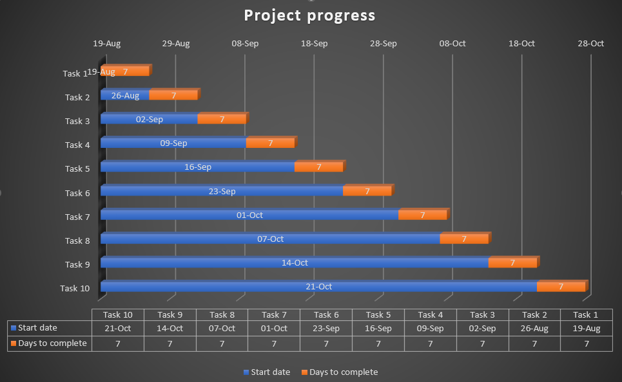
Project Plan

Slide 6
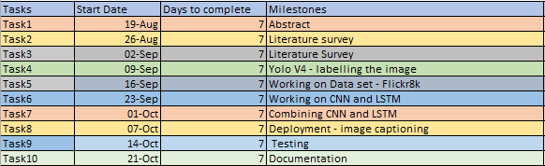
Project Plan

Slide 7
Literature Survey
Sl.no | Title of the Paper | Year | Author | Key Findings | Research Gap
 | Image caption generation using Visual Attention Prediction and Contextual Spatial Relation Extraction | 2023 | Reshmi Sasibhooshan, Suresh Kumaraswamy & Santhoshkumar Sasidharan | Approach: The paper introduces a new method for generating image captions that combines a Wavelet-based CNN and LSTM, enhanced by attention mechanisms to focus on key details and relationships within images. Technique: By using wavelet decomposition and attention networks, the model captures detailed features and spatial relationships between objects, leading to more accurate and descriptive captions. Results: The model performs better than previous methods, achieving higher accuracy and relevance in captions across popular datasets like Flickr8K and MSCOCO. | Spatial Relationships: Previous models struggled with understanding the spatial relationships between objects, which is crucial for generating coherent captions. Detail and Context: Earlier methods often missed fine details, like color or object count, which are important for creating accurate and meaningful captions. Focused Attention: There was a need for better attention mechanisms to help models focus on the most relevant parts of an image, which this paper addresses with its innovative approach.

Slide 8
Literature Survey
Sl.no | Title of the Paper | Year | Author | Key Findings | Research Gap
2. | Image Captioning - A deep learning approach using CNN and LSTM Network | 2023 | Preeti Voditel, Aparna Gurjar, Aakansha Pandey, Akrati Jain, Nandita Sharma | Approach:The study aims to develop a system that automatically generates descriptive sentences for images using the Flickr8k dataset. Technique:A CNN extracts visual features from the images, and an LSTM converts these features into descriptive sentences, linking vision with language. Result:The system achieves around 60% accuracy in matching its captions to reference captions, demonstrating its effectiveness in image description. | Focus and Relevance: The model could benefit from an attention mechanism to better focus on key parts of an image, improving the accuracy and relevance of the captions. Deeper Meaning: While the captions are generally accurate, there’s a need to enhance how well they capture the deeper meaning and context of the images. Broader Application: Future work should look into how the model can be adapted to handle more complex images and different datasets, ensuring it performs well across a broader range of scenarios.

Slide 9
Literature Survey
Sl.no | Title of the Paper | Year | Author | Key Findings | Research Gap
3. | Automatic image captioning combining natural language processing and deep neural networks | 2023 | Antonio M. Rinaldi, Cristiano Russo, Cristian Tommasino | Approach:Combining natural language processing with computer vision to create models capable of automatically generating descriptive captions for images. Technique:Using deep neural networks, particularly convolutional neural networks (CNNs) for feature extraction and recurrent neural networks (RNNs) with attention mechanisms for sentence generation. Results: Enhanced accuracy and detail in the generated captions, making the model effective for real-world applications in automatic image captioning. | Complex Scene Understanding: Current models struggle with accurately captioning images that involve multiple objects, intricate interactions, or abstract concepts, indicating a need for improved scene understanding. Generalization Across Datasets: Models often lack robustness when applied to diverse datasets or real-world scenarios, highlighting the gap in developing models that can generalize effectively beyond the training data. Contextual and Cultural Awareness: There is a need for models that can generate captions with deeper contextual and cultural understanding, as current models may fail to capture subtleties or context-specific details in images

Slide 10
Literature Survey
Sl.no | Title of the Paper | Year | Author | Key Findings | Research Gap
4. | A Comprehensive Survey of Deep Learning for Image Captioning | 2019 | MD. Zakir Hossain, Ferdous Sohel, Mohd Fairuz Shiratuddin, and Hamid Laga | Approach:The paper reviews and categorizes deep-learning methods for generating image captions, emphasizing novel techniques that leverage CNNs, RNNs, and attention mechanisms. Technique:It focuses on caption generation using Convolutional Neural Networks (CNNs) for feature extraction, Recurrent Neural Networks (RNNs) for sequence modeling, and attention mechanisms to improve context relevance. The paper also discusses datasets like MS COCO and metrics like BLEU (Bilingual Evaluation Study)and CIDEr(Classless Inter Domain Routing) for evaluating caption quality. Result:The paper compares various deep learning techniques, highlighting their strengths, limitations, and performance in generating accurate and contextually relevant image captions. | Handling Unseen Objects: Existing models struggle with generating captions for objects not present in the training data, highlighting the need for more robust systems that can handle novel objects. Semantic Understanding: There's a need for improved models that better integrate high-level semantic concepts to produce more meaningful captions. Enhanced Attention Mechanisms: Current attention models require further development to more closely mimic human perception and dynamic focus in caption generation.

Slide 11
Literature Survey
Sl.no | Title of the Paper | Year | Author | Key Findings | Research Gap
5. | Automatic image caption generation using deep learning | 2023 | Akash Verma, Arun Kumar Yadav, Mohit Kumar, Divakar Yadav | Approach:The paper proposes an encoder-decoder model for automatic image captioning using VGG16 Hybrid Places 1365 as the encoder and LSTM as the decoder. The VGG16 Hybrid Places 1365 model is pre-trained on both the ImageNet and Places365 datasets, aiming to capture both object-specific and scene-specific features. Technique:The model is trained and evaluated on Flickr8k and MS-COCO Captions datasets. It uses BLEU, METEOR, ROUGE L, and GLEU metrics for comprehensive evaluation. Results:The proposed model achieved a BLEU-1 score of 0.6666 on the Flickr8k dataset and 0.7350 on the MS-COCO Captions dataset, indicating a significant performance improvement over state-of-the-art approaches. | Scene-Specific vs. Object-Specific Models:Most existing models are trained on the object-specific ImageNet dataset, leading to object-centric captions. The proposed model addresses this by using a hybrid approach that incorporates scene-specific data. Limited Evaluation Metrics:Many studies report results using only a limited set of evaluation metrics, which may not provide a comprehensive assessment of model performance. The proposed study addresses this by evaluating the model across all major metrics.

Slide 12
Analysis - SWOT
Strengths
Weaknesses
S1. Innovative Technology
S2. Comprehensive Integration
S3.Global Impact Potential
W1.Complex Integration
W2. Data Dependency
W3.User Adaptation & Privacy Issues
Opportunities
Threats
O1.Growing Market
O2.Collaborative Potential
O3.Customizability & Innovation
T1. Technological Obsolescence & Competition
T2.Regulatory & Privacy Challenges.
T3.Funding & Resource Constraints

Slide 13
Analysis – 4W1H
Why: Vision impairments affect over 2.2 billion people globally, with 70 million in India alone. These impairments significantly hinder daily activities such as reading, socializing, and navigating environments. To address these challenges and enhance accessibility, a solution that translates visual information into auditory descriptions is needed.
What: The "Vision to Sound: Enhancing Accessibility for the Visually Impaired" project aims to develop a system that converts visual information into auditory descriptions. This system will help visually impaired individuals perceive their surroundings through sound by analyzing images and providing meaningful auditory feedback.
Where: The system will be deployed on a compact, portable embedded platform, making it practical for use in various environments. The solution is designed to be used in everyday situations where visual information needs to be conveyed audibly.
When: The project is scheduled for completion by October 2024. The timeline includes the development of algorithms, integration with embedded systems, and testing of the final product.
How: The project utilizes convolutional neural networks (CNNs) to analyze images, identifying objects, scenes, and text. Natural language processing (NLP) techniques then generate coherent descriptions of the detected elements. Text-to-speech synthesis is used to convert these descriptions into audible speech, delivered through headphones or speakers. The system is designed to be compact, portable, and capable of real-time processing with low power consumption.
Refined Objective: To develop a compact, real-time system that integrates advanced machine learning algorithms with embedded technology to convert visual information into accurate and meaningful auditory descriptions, thereby enhancing accessibility and independence for visually impaired individuals. The system will analyze images to detect objects, scenes, and text, and provide real-time auditory feedback, significantly improving the daily lives of users.

Slide 14
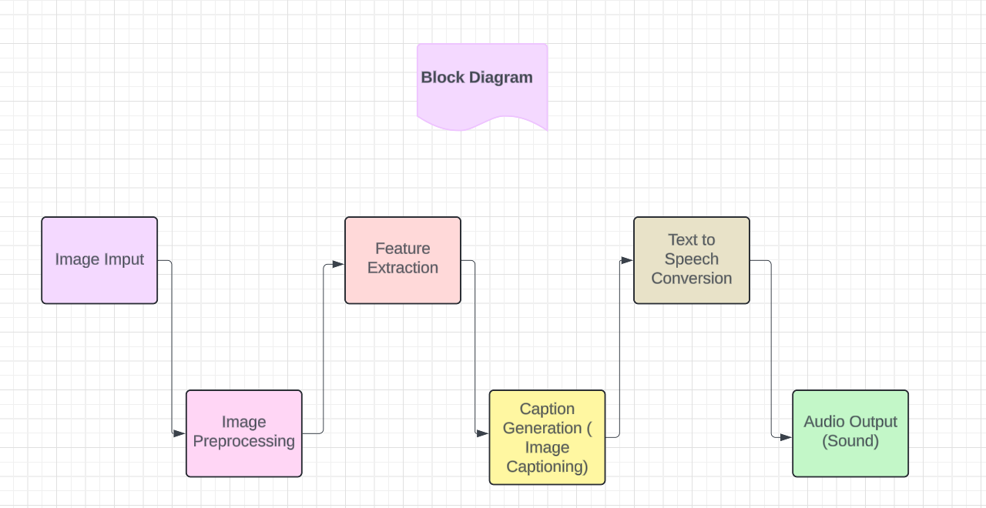
Architecture
Structural Diagram

Slide 15
Use Cases & Testing
Use Cases
Image Detection with YOLO V4
Image Feature Extraction with CNN
Sequential Caption Generation with LSTM
Training on Image-Caption Pairs
Test Cases
Image Detection Accuracy
Caption Generation Quality

Slide 16
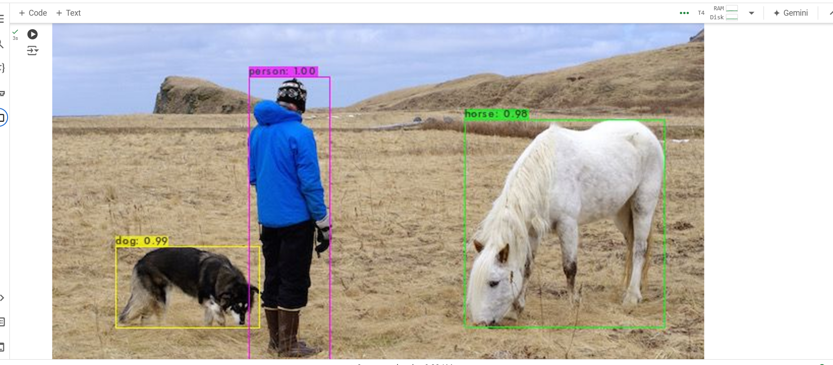
Implementation and Results – Iteration 1
Iteration 1 : Labelling of the image

Slide 17
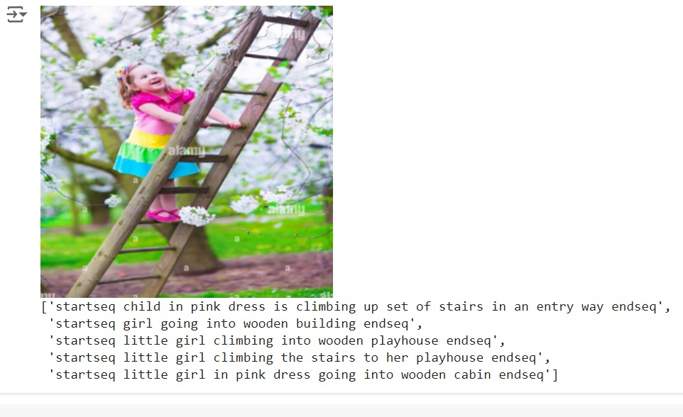
Implementation and Results – Iteration 2
Iteration : Image Captioning

Slide 18
Contribution
Team Progress and Movement
YOLO V4 Image Labeling completed.
Flickr 8k Image Captioning implemented.
Integration of Image Processing progressing.
Individual Contribution
Key contributions: Alli Gopi
collection of dataset
image captioning
Key contributions: Bhoomika N
collection of dataset
Labelling of the image

Slide 19
Conclusion & Future Work
Summary and Conclusion:
Image Labeling
Image Caption Generation
Utilization of Flickr 8k Dataset
Future Work:
Real-Time Data Integration
Caption Generation
Voice Conversion
Multilingual Support
Language-Specific Models

Slide 20

THANK YOU

